Slide 1
Evolutionary Algorithm to ab initio Protein Structure Prediction with Hydrophobic Interactions
T. W. de Lima, P. H. R. Gabriel, A. C. B. Delbem, R. A. Faccioli and I. N. da Silva,
2007 IEEE Congress on Evolutionary Computation (CEC 2007), pp. 612 - 619 .
Presenter : Hsiao-Yen Chang
Date : March 5, 2008

Slide 2
Abstract
Proteins are polymers whose chains are composed of 20
different monomers, called amino acids. The problem of Protein
Structure Prediction (PSP) is the determination of protein 3D
conformation from its amino acid sequence. Two main strategies
are usually employed to work with PSP: homology and Ab initio
approaches. This paper presents an Evolutionary Algorithm to
PSP using an Ab initio approach (ProtPred). The predictions are
evaluated using fitness functions based on potential energies
and hydrophobic interactions. The proposed approach uses
dihedral angles and main angles of the lateral chains to model a
protein structure. ProtPred is evaluated using relatively complex
cases for an Ab initio approach. Results have shown that
ProtPred is a consistent approach.

Slide 3
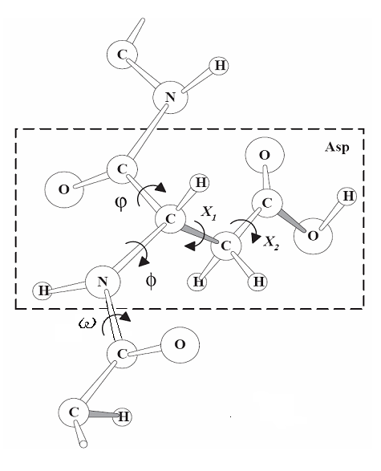
A. Representation of the conformation
There are few conformations and representations commonly used:
  all-atom three-dimensional coordinates;
  all-heavy-atom coordinates;
  backbone atom coordinates and side-chain centroid;
  C_{α} coordinates;
  backbone and side-chain torsion angles;
  lattice models.

Slide 4
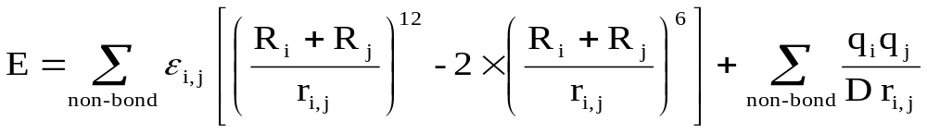
B. Cost Function
Potential Energy Function: The most typical potential energy functions have the following form [20]:
where R is a vector representing the molecule conformation, typically in Cartesian coordinates or torsion angles.
ProtPred uses only van der Waals and electrostatic energies as following:
where (i) ε_{i,j} is the Leonard-Jones well depth, r_{i,j} is the distance between atoms i and j, R_{i} is the van der Waals atom i radius, R_{j} is the van der Waals atom j radius; (ii) q_{i} and q_{j} are the partial atomic charges from atom i and j and D is the dielectric constant.

Slide 5
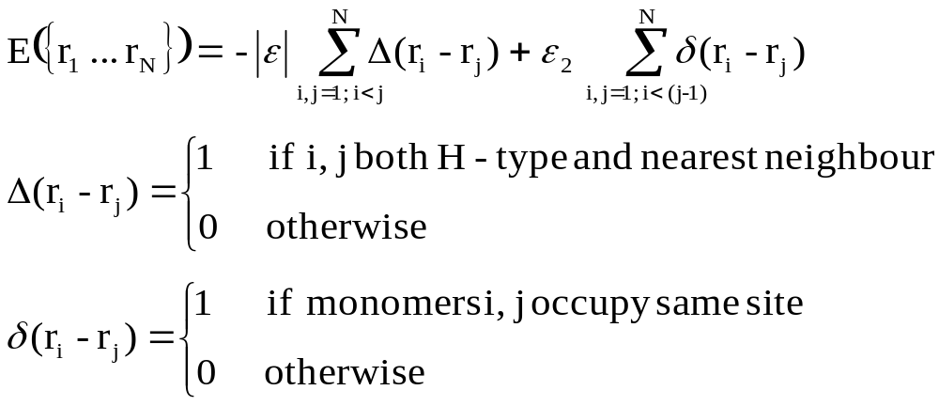

B. Cost Function (cont.)
Hydrophobic Interaction Energy Function：The energy function for this model is:
where
|ε| ≡ strength of HH attraction.
ε₂ ≡ energetic penalty parameter for sites containing two or more monomers.

Slide 6
C. ProtPred
The backbone torsion angles are constrained in regions derived from the CADB-2.0 database, witch contains most torsion angles to each residue.
Side-chain constraint regions are of the form: [m − σ, m + σ], where m and σ are, respectively, the mean and the standard deviations for each side-chain torsion angle computed from the rotamer library of Tuffery.

Slide 7
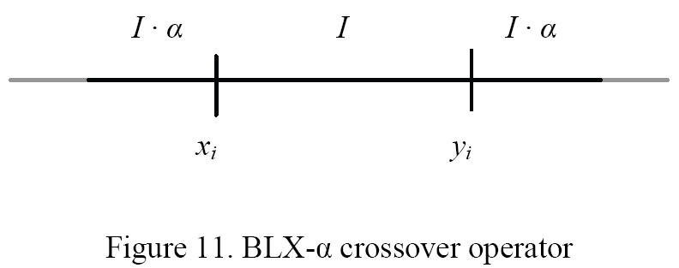
C. ProtPred (cont.)
We proposed three kinds of recombination operators: BLX-α、uniform、two-point crossover.
Let us suppose that x = (x₁, …, x_{n}) and y = (y₁, …, y_{n}) where x_{i}, y_{i} ⊂ℜ are two selected parents for reproduction of offspring. BLX-α randomly generates one offspring: z = (z₁, …, z_{n}) where z_{i} is a randomly chosen number from the interval [c_{min} - Iα,c_{max} + Iα], where c_{min} = min(x_{i}, y_{i}), c_{max} = max(x_{i}, y_{i}), and I = c_{max} – c_{min} .

Slide 8
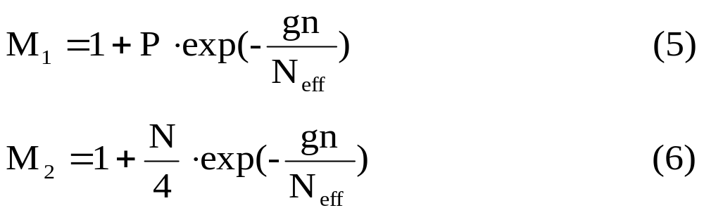
C. ProtPred (cont.)
For the purposes of preventing premature convergence and random walk, we made M₁ and M₂ decrease as the search proceeds, as shown in Equation 5 and 6
where P is the population size, N is a number of residues in the protein, gn is the generation, and N_{eff} is a constant (set to 150).

Slide 9
C. ProtPred (cont.)
We made a copy of the parents individuals and modified this copied population M₁ times, each time by applying the operator to a randomly selected individual from this population. An individual can be selected more than once; consequently so there may be changes in torsion angles in more than one residue in a chromosome.
The second and the third mutation operator perturb all the values of the backbone and side-chain torsion angles of a selected residue using a uniform distribution. The number of perturbed residues of each individual is M₂.
Second operator uses random numbers in [0,1], generated from a uniform distribution. Third operator is similar to second operator, the random numbers are in [0, 0.1].

Slide 10
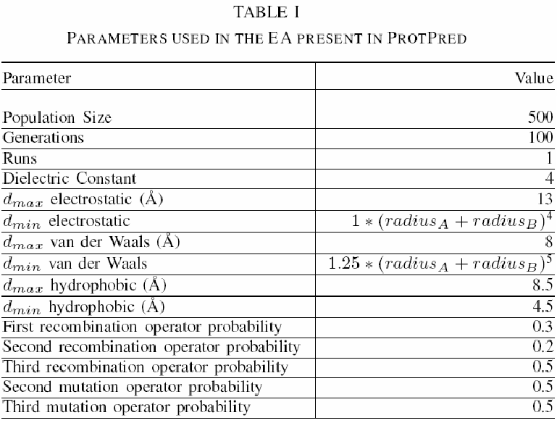
Results
This algorithm was applied to four protein sequences from the Protein Data Bank3 (PDB): 1A11(25), 1ALE(18), 1DEP(15) and 1DU1(20).

Slide 11
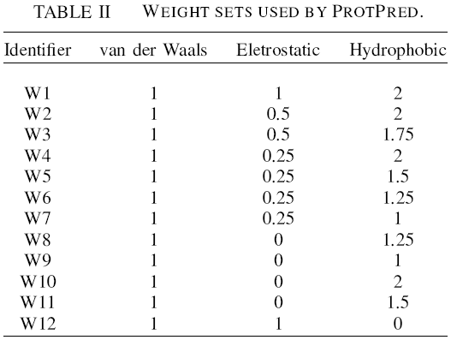
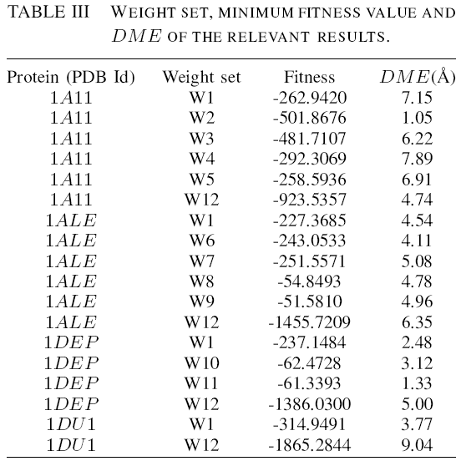
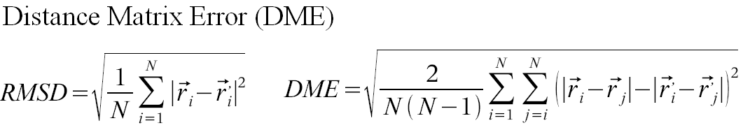
Results (cont.)

